Slide 1
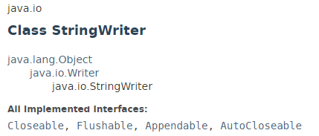
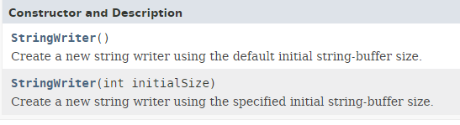
Java IO: StringWriter
A character stream that collects its output in a string buffer, which can then be used to construct a string.
The Java StringWriter class (java.io.StringWriter) enables you to obtain the characters written to a Writer as a String.
The StringWriter is useful if you have a component that only can write data to a Writer but you need that data as a String.
When you are finished writing characters to a Java StringWriter you can close. Since the StringWriter is not connected to any underlying system resources, like files or network connections, it is not crucial to close it.

Slide 2
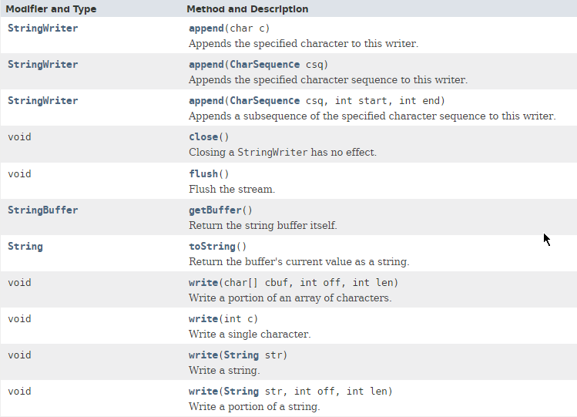
Java IO: StringWriter

Slide 3
Java IO: StringWriter
https://docs.oracle.com/javase/8/docs/api/index.html?java/io/StringWriter.html

